Slide 1
Adventures in Crypto Dark Matter: Attacks and Fixes for Weak Pseudorandom Functions
Wonhee cho¹
Joint work with Jung Hee Cheon¹, Jeong Han Kim² and Jiseung Kim²
¹Seoul National University and ²Korea Institute for Advanced Study(KIAS)
2021. 05. 12

Slide 2
Outline
Backgrounds
Our works: Attack and Fix of Weak PRFs
Further works

Slide 3
Pseudorandom Functions
Informally, a pseudorandom function “looks like” a random function
Applications:
HMAC, Digital signature, Indistinguishability obfuscation(iO), Block ciphers etc.
Important tools in the construction of cryptographic primitives
Notes:
Weak PRF is widely used in cryptography

Slide 4






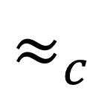


Pseudorandom Functions
Deterministic keyed function $F_{k}:X →Y$
Efficiently-computable
Input-output behavior indistinguishable from truly random function $f:X →Y$
Weak PRF: $x_{i}$’s are chosen uniformly random
$$x_{i}$$
$$F_{k}$$
$$x_{i}$$
$$f$$
$$≈_{c}$$
$$F_{k}(x_{i})$$
$$f(x_{i})$$
Picture: David Wu slide in Lower Bounds in Cryptography
Notes:
Weak PRF is widely used in cryptography

Slide 5
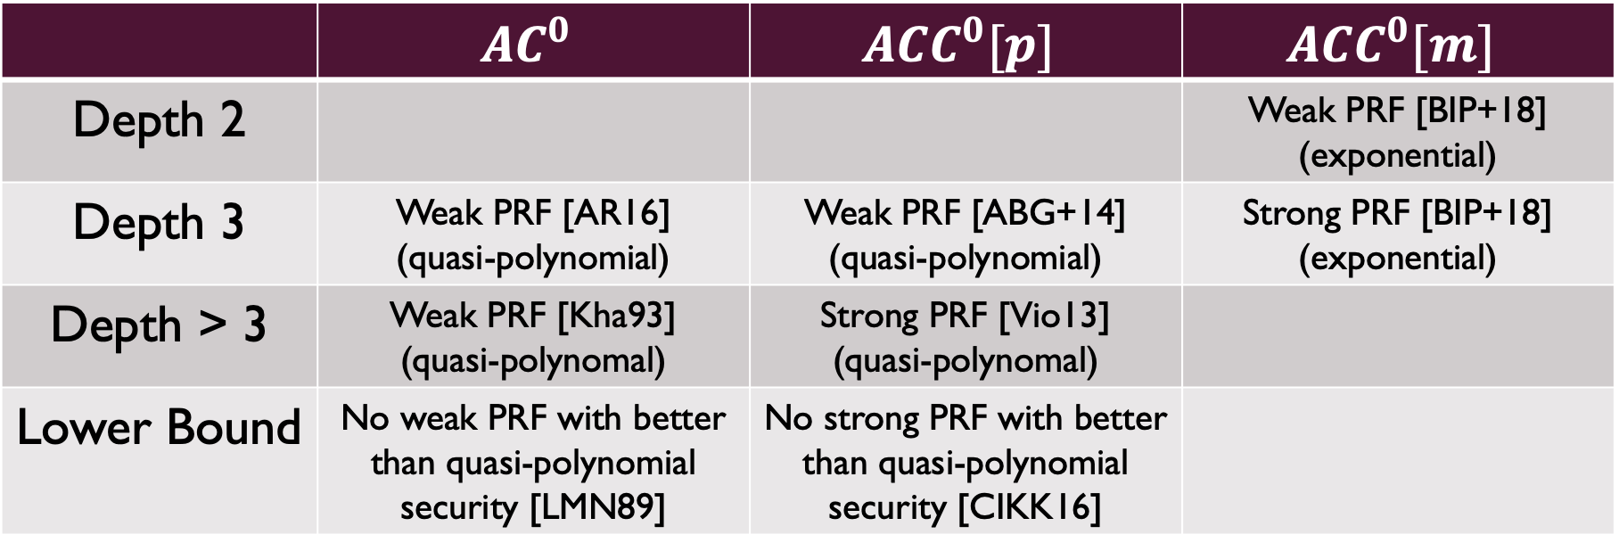
Brief status of Pseudorandom function
 | $$AC^{0}$$ | $$A{CC}^{0}[p]$$ | $$A{CC}^{0}[m]$$
Depth 2 |  |  | Weak PRF [BIP+18] (exponential)
Depth 3 | Weak PRF [AR16] (quasi-polynomial) | Weak PRF [ABG+14] (quasi-polynomial) | Strong PRF [BIP+18] (exponential)
Depth > 3 | Weak PRF [Kha93] (quasi-polynomal) | Strong PRF [Vio13] (quasi-polynomal)
Lower Bound | No weak PRF with better than quasi-polynomial security [LMN89] | No strong PRF with better than quasi-polynomial security [CIKK16]
Notes:
They use 5 to 6 pages for only scheme description

Slide 6
Exploring Crypto Dark Matter’s weak PRF candidates
Simple Construction
Mix linear computations over different moduli
Low depth circuit complexity
First proposed depth-2 weak PRF candidates
First proposed depth-3 PRF candidates
(Conjecture) Exponential security
Notes:
Depth가 낮을수록 parallel computing에서 유리

Slide 7
The Landscape of Cryptography
Modulus Mixing
Mmap
Lattice
SHA-256
AES
DES
FE
iO
Pairings
Factoring
PRG
Crypto Dark Matter
Picture: David Wu slide in Lower Bounds in Cryptography
Notes:
Depth가 낮을수록 parallel computing에서 유리

Slide 8
This work
Introduce a new direct statistical attack using conditional probability
Apply the attack to Dark Matter’s weak PRF candidates
Breaking an alternative weak PRF candidates suggested parameter (with exponentially many samples)
Breaking a new weak PRF candidates suggested parameter (with circulant matrix and exponentially many samples)
Notes:
Weak PRF is widely used in cryptography

Slide 9
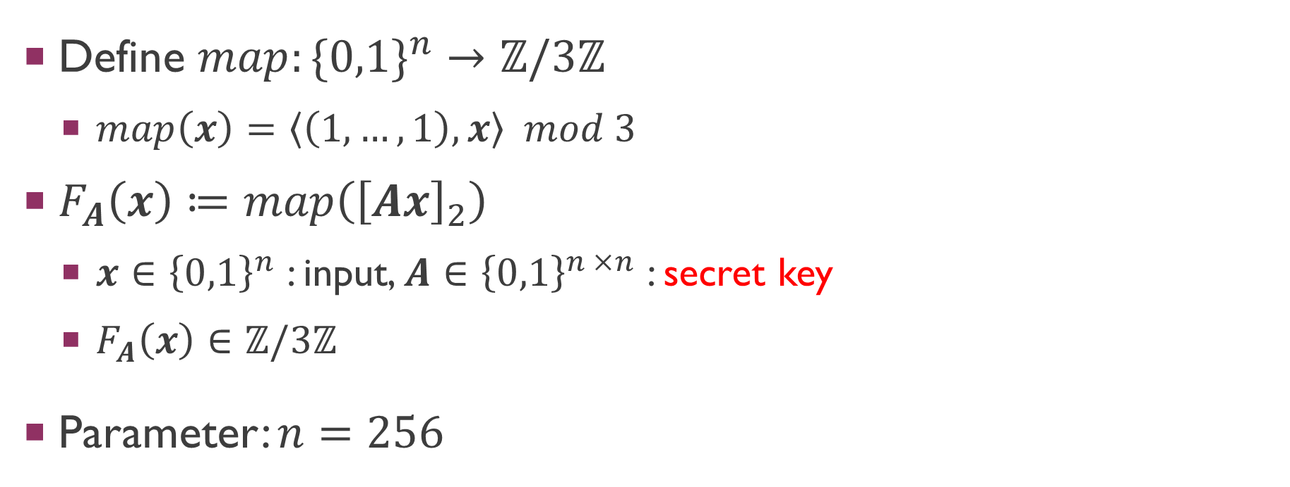
Dark Matter’s New Weak PRF Candidate
Define $map:\{0,1\}^{n}→ℤ/3ℤ$
$map\left(x\right)=\left\langle \left(1,…,1\right),x\right\rangle mod 3$
$F_{A}\left(x\right)≔map\left({\left[Ax\right]}_{2}\right)$
$x∈{\left\{0,1\right\}}^{n}$ : input, $A∈{\left\{0,1\right\}}^{n ×n}$ : secret key
$F_{A}\left(x\right)∈ℤ/3ℤ$
Parameter: $n=256$

Slide 10
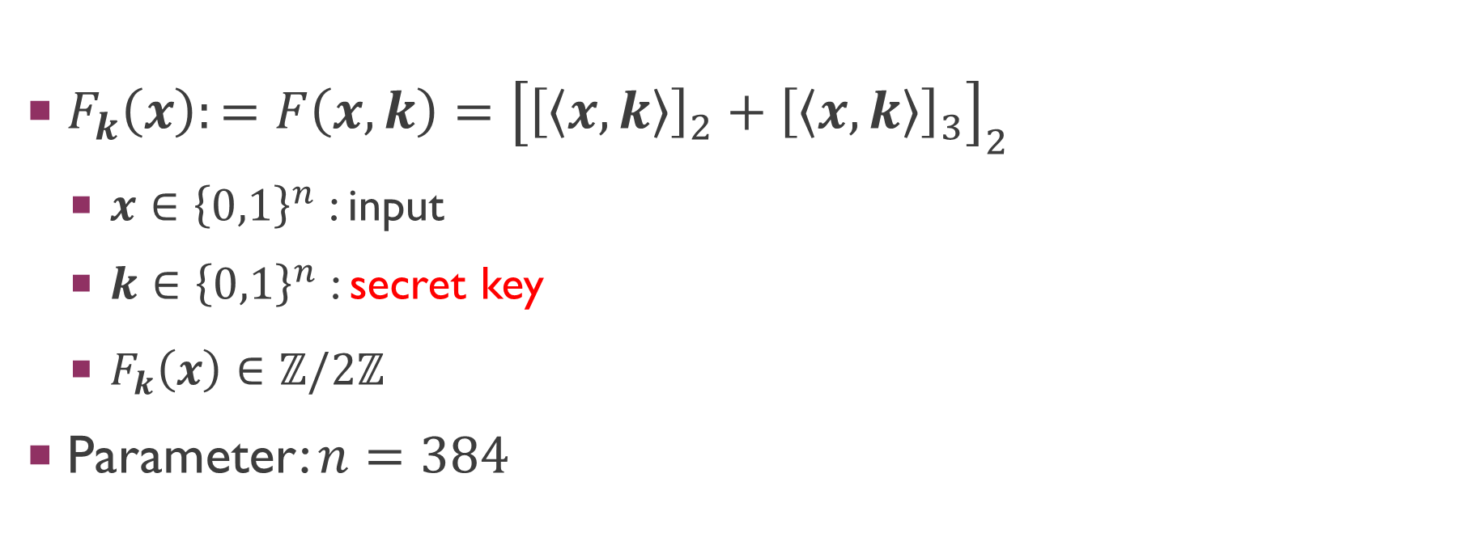
Dark Matter’s Alternative Weak PRF Candidate
$F_{k}\left(x\right):=F\left(x,k\right)={\left[{\left[\left\langle x,k\right\rangle \right]}_{2}+{\left[\left\langle x,k\right\rangle \right]}_{3}\right]}_{2}$
$x∈{\left\{0,1\right\}}^{n}$ : input
$k∈{\left\{0,1\right\}}^{n}$ : secret key
$F_{k}\left(x\right)∈ℤ/2ℤ$
Parameter: $n=384$

Slide 11
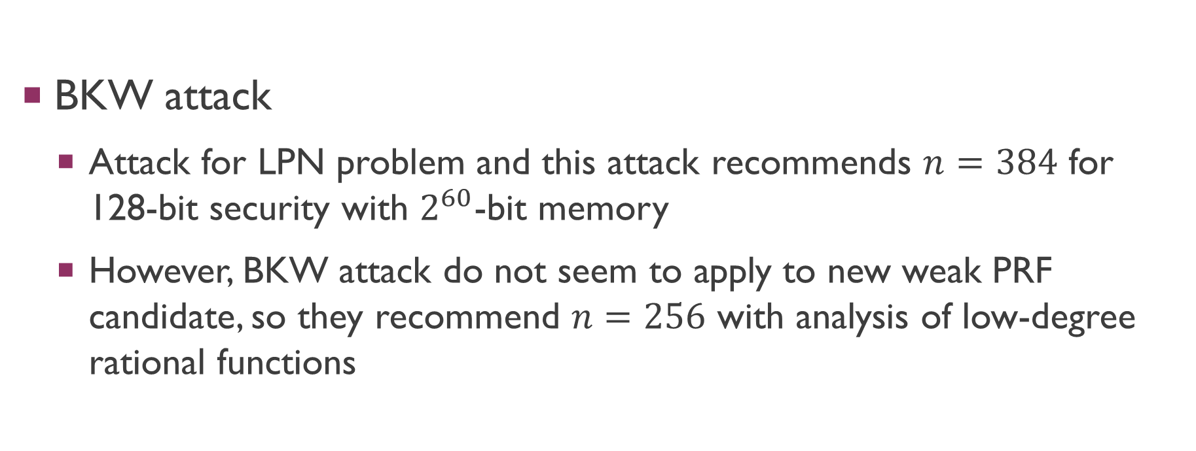
Parameter selection
BKW attack
Attack for LPN problem and this attack recommends $n=384$ for 128-bit security with $2^{60}$-bit memory
However, BKW attack do not seem to apply to new weak PRF candidate, so they recommend $n=256$ with analysis of low-degree rational functions

Slide 12
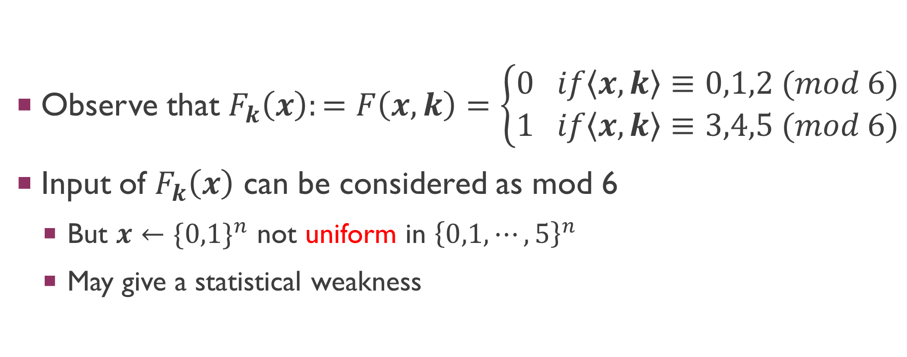
Our Attack: Intuition
Observe that $F_{k}\left(x\right):=F\left(x,k\right)=\left\{\begin{aligned}0 if\left\langle x,k\right\rangle ≡0,1,2 (mod 6) \\ 1 if\left\langle x,k\right\rangle ≡3,4,5 (mod 6)\end{aligned}\right.$
Input of $F_{k}\left(x\right)$ can be considered as mod 6
But $x←\{0,1\}^{n}$ not uniform in ${\left\{0,1,⋯,5\right\}}^{n}$
May give a statistical weakness

Slide 13
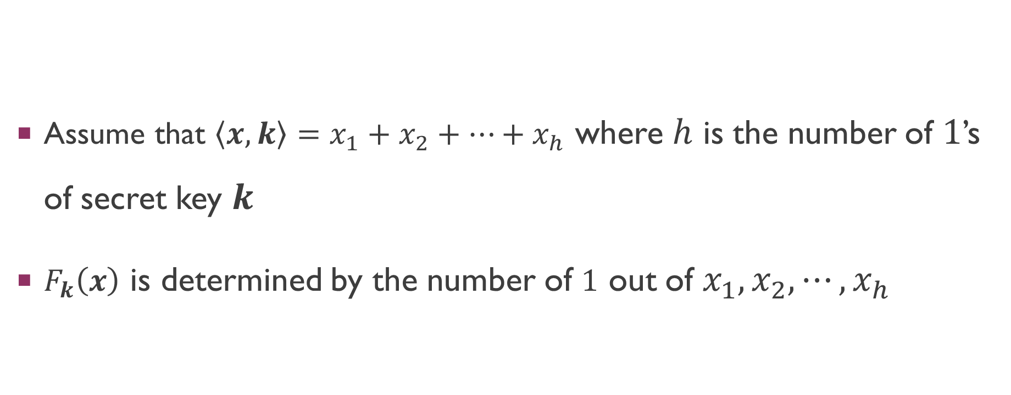
Our Attack: Intuition
Assume that $\left\langle x,k\right\rangle =x_{1}+x_{2}+⋯+x_{h}$ where $h$ is the number of $1$’s of secret key $k$
$F_{k}\left(x\right)$ is determined by the number of $1$ out of $x_{1},x_{2},⋯{,x}_{h}$

Slide 14

Key idea
$f\left(n,t\right)= \sum_{k=0}^{\left\lfloor n/t\right\rfloor }{\left({n \atop kt}\right)}=\left({n \atop 0}\right)+\left({n \atop t}\right)+\left({n \atop 2t}\right)+⋯=?$
$t=2 :f\left(n,2\right)=2^{n−1}$
$t=3 :f\left(n,3\right)={(2}^{n}±1)/3$
$t=k :f\left(n, k\right)= ?$

Slide 15
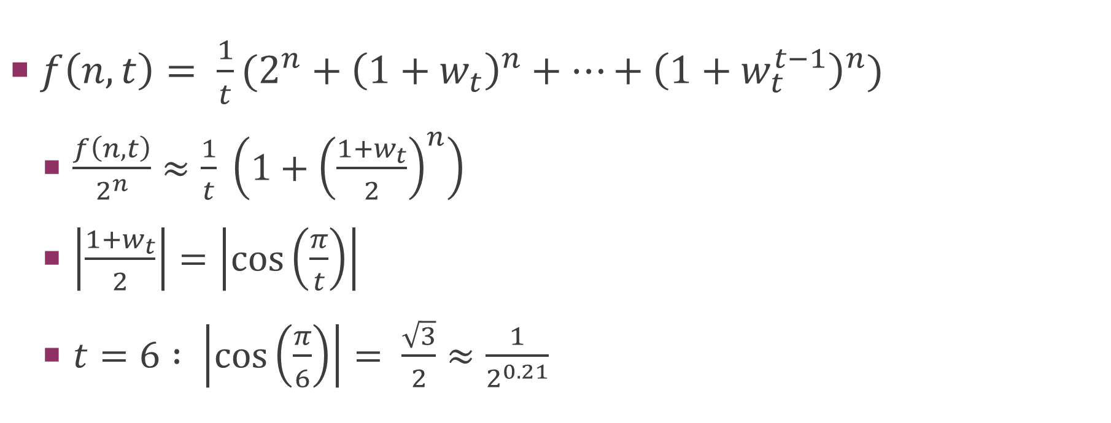
Key idea
$f\left(n,t\right)= \frac{1}{t}(2^{n}+{\left(1+w_{t}\right)}^{n}+…+{\left(1+w_{t}^{t−1}\right)}^{n})$
$\frac{f\left(n,t\right)}{2^{n}}≈\frac{1}{t} \left(1+{\left(\frac{1+w_{t}}{2}\right)}^{n}\right)$
$\left|\frac{1+w_{t}}{2}\right|=\left|\cos\left(\frac{π}{t}\right)\right|$
$t=6 : \left|\cos\left(\frac{π}{6}\right)\right|= \frac{\sqrt{3}}{2}≈\frac{1}{2^{0.21}}$

Slide 16
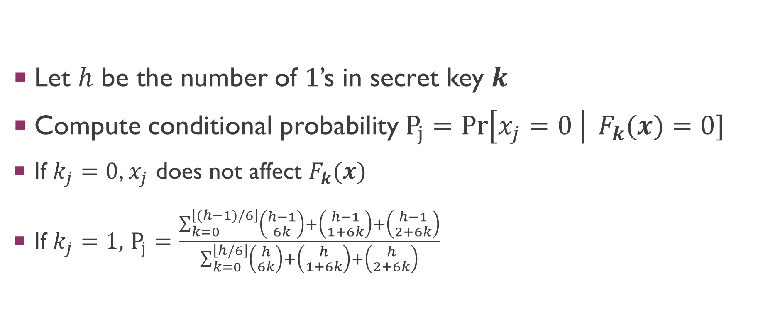
Attack for alternative weak PRF candidate
Let $h$ be the number of $1$’s in secret key $k$
Compute conditional probability $P_{j}=\operatorname{Pr}\left[x_{j}=0 \right| F_{k}(x)=0]$
If $k_{j}=0$, $x_{j}$ does not affect $F_{k}(x)$
If $k_{j}=1,$ $P_{j}=\frac{\sum_{k=0}^{\left\lfloor (h−1)/6\right\rfloor }{\left({h−1 \atop 6k}\right)+\left({h−1 \atop 1+6k}\right)+\left({h−1 \atop 2+6k}\right)}}{\sum_{k=0}^{\left\lfloor h/6\right\rfloor }{\left({h \atop 6k}\right)+\left({h \atop 1+6k}\right)+\left({h \atop 2+6k}\right)}}$

Slide 17
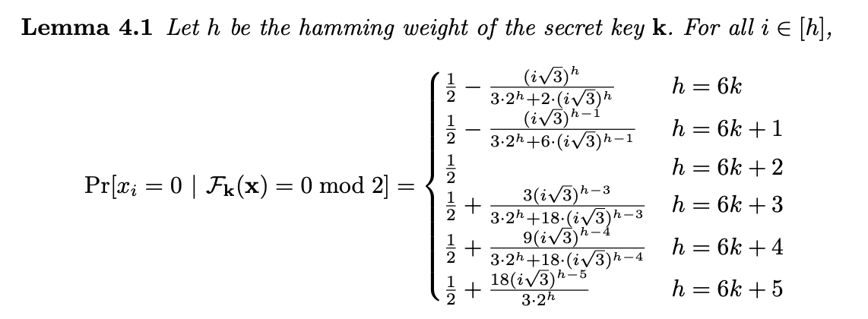
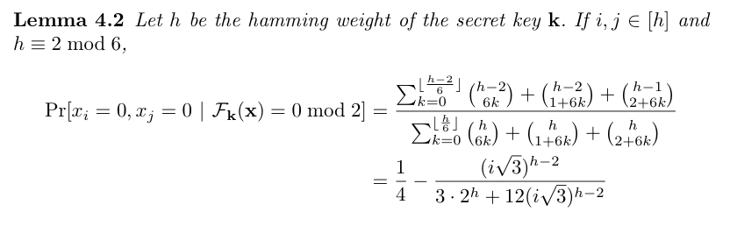
Attack for alternative weak PRF candidate

Slide 18
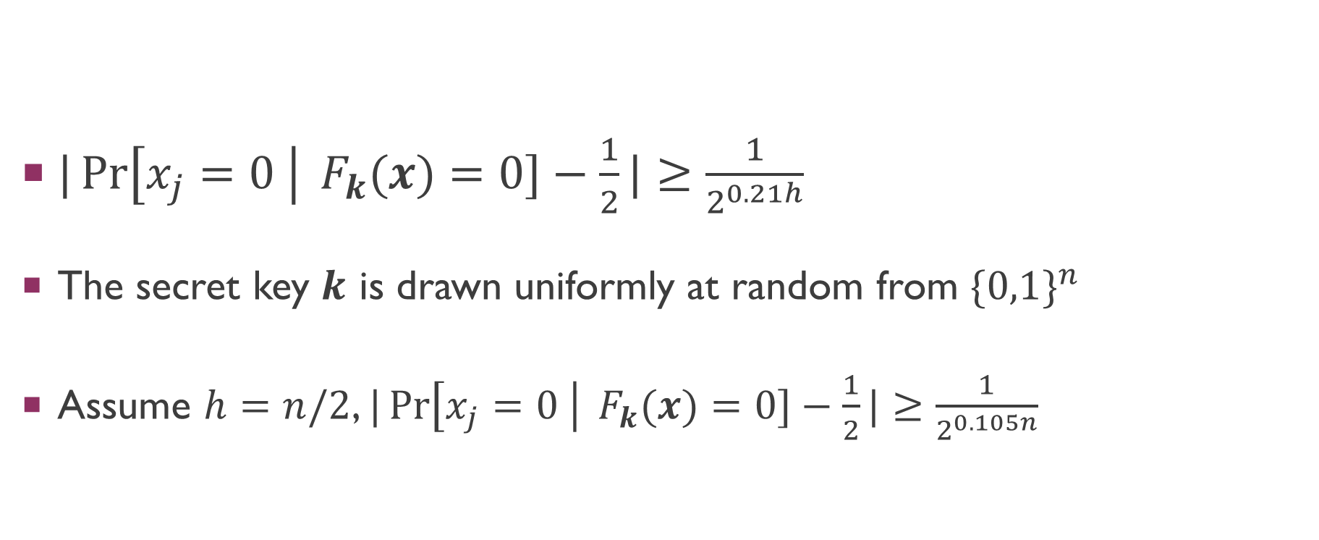
Attack for alternative weak PRF candidate
$|\operatorname{Pr}\left[x_{j}=0 \right| F_{k}(x)=0]−\frac{1}{2}|≥\frac{1}{2^{0.21h}}$
The secret key $k$ is drawn uniformly at random from $\{0,1\}^{n}$
Assume $h=n/2$, $|\operatorname{Pr}\left[x_{j}=0 \right| F_{k}(x)=0]−\frac{1}{2}|≥\frac{1}{2^{0.105n}}$

Slide 19
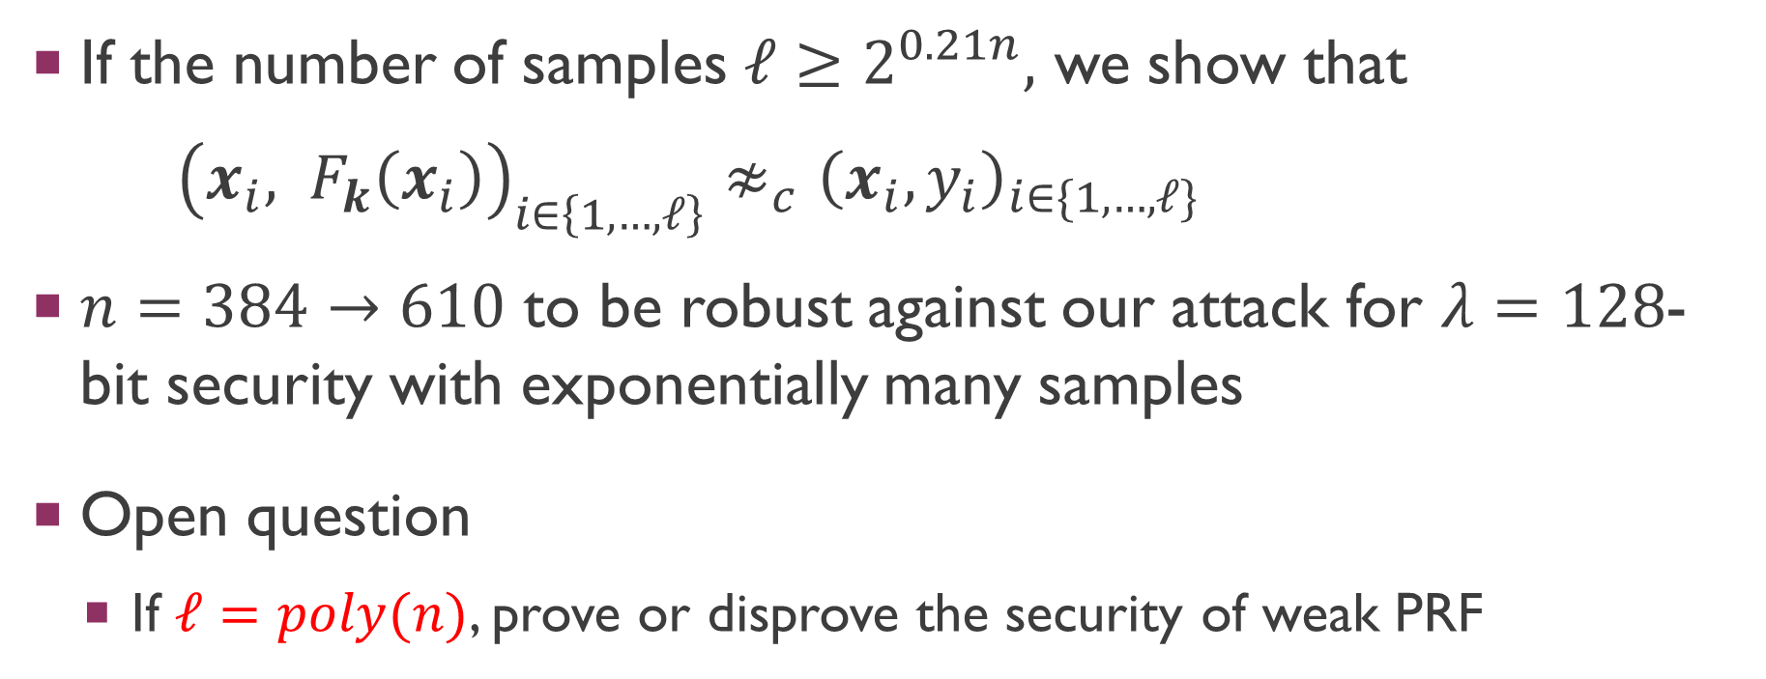
Attack for alternative weak PRF candidate
If the number of samples $ℓ≥2^{0.21n},$ we show that
${\left(x_{i}, F_{k}\left(x_{i}\right)\right)}_{i∈\left\{1,…,ℓ\right\}}≉_{c}{\left(x_{i},y_{i}\right)}_{i∈\{1,…,ℓ\}}$
$n=384→610$ to be robust against our attack for $λ=128$-bit security with exponentially many samples
Open question
If $ℓ=poly(n)$, prove or disprove the security of weak PRF

Slide 20
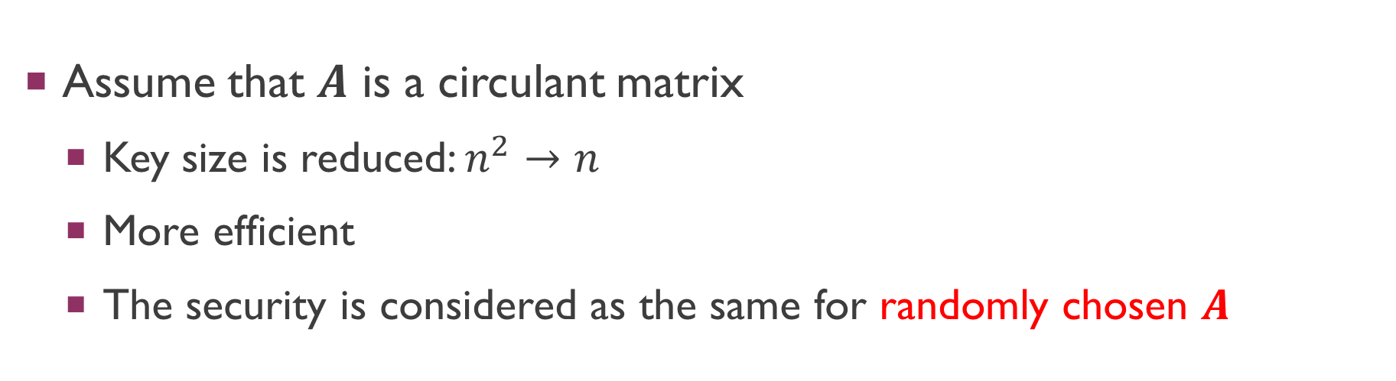
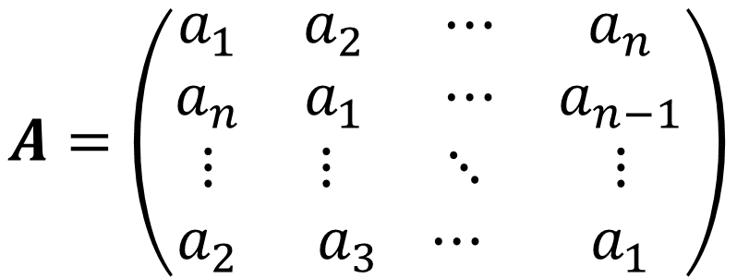
Attack for new weak PRF candidate
Assume that $A$ is a circulant matrix
Key size is reduced: $n^{2}→n$
More efficient
The security is considered as the same for randomly chosen $A$
$$A=\left(\begin{matrix}\begin{aligned}a_{1} \\ a_{n}\end{aligned} & \begin{aligned}a_{2} ⋯ \\ a_{1} ⋯\end{aligned} & \begin{aligned}a_{n} \\ a_{n−1}\end{aligned} \\ ⋮ & ⋮ ⋱ & ⋮ \\ a_{2} & a_{3} ⋯ & a_{1}\end{matrix}\right)$$

Slide 21
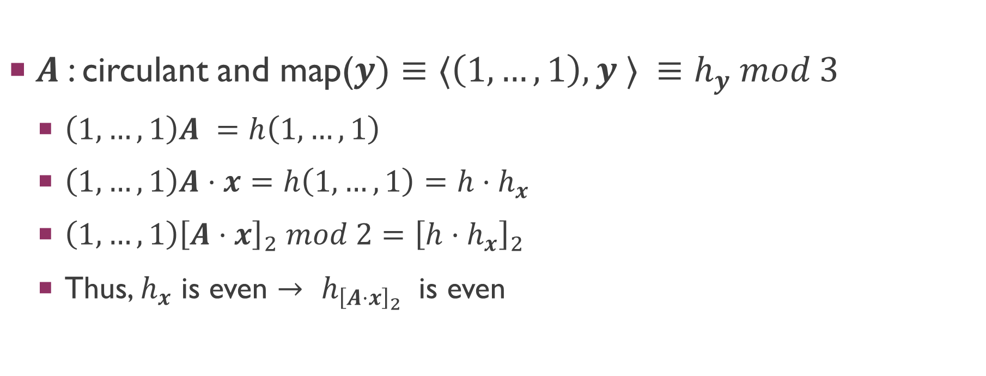
Attack for new weak PRF candidate
$A$: circulant and map($y)≡⟨\left(1,…,1\right),y ⟩ ≡h_{y} mod 3$
$\left(1,…,1\right)A =h\left(1,…,1\right)$
$\left(1,…,1\right)A⋅x=h\left(1,…,1\right)=h⋅h_{x}$
$\left(1,…,1\right){\left[A⋅x\right]}_{2} mod 2={\left[h⋅h_{x}\right]}_{2}$
Thus, $h_{x}$ is even $→$ ${h_{{\left[A⋅x\right]}_{2}}}_{ }$ is even

Slide 22
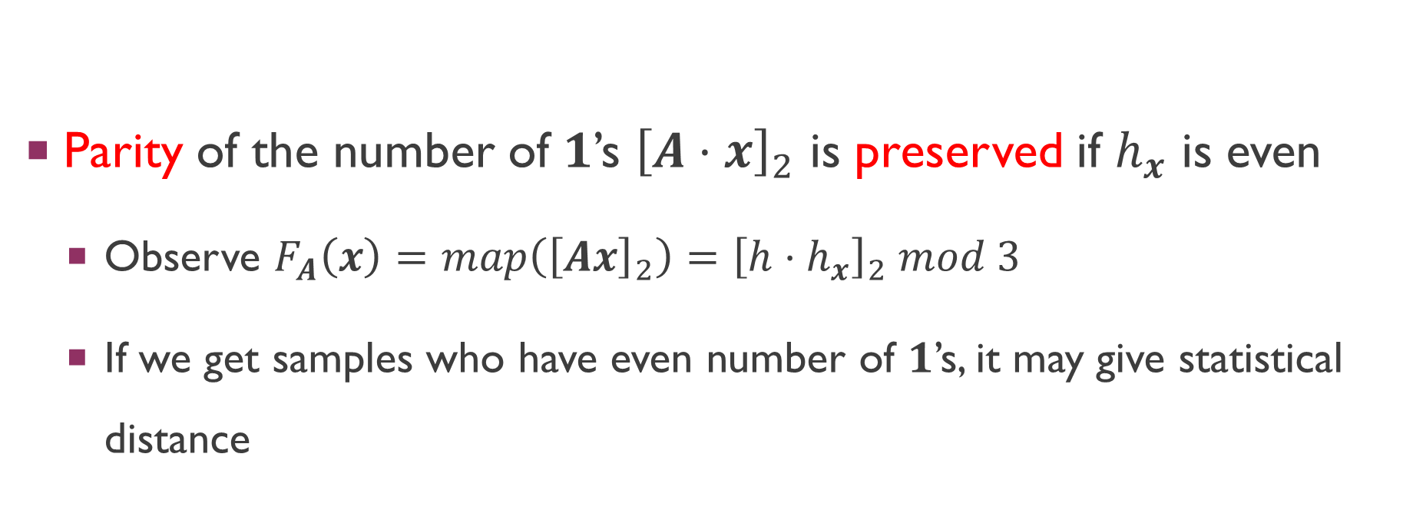
Attack for new weak PRF candidate
Parity of the number of $1$’s ${\left[A⋅x\right]}_{2}$ is preserved if $h_{x}$ is even
Observe $F_{A}\left(x\right)=map\left({\left[Ax\right]}_{2}\right)={\left[h⋅h_{x}\right]}_{2} mod 3$
If we get samples who have even number of $1$’s, it may give statistical distance

Slide 23
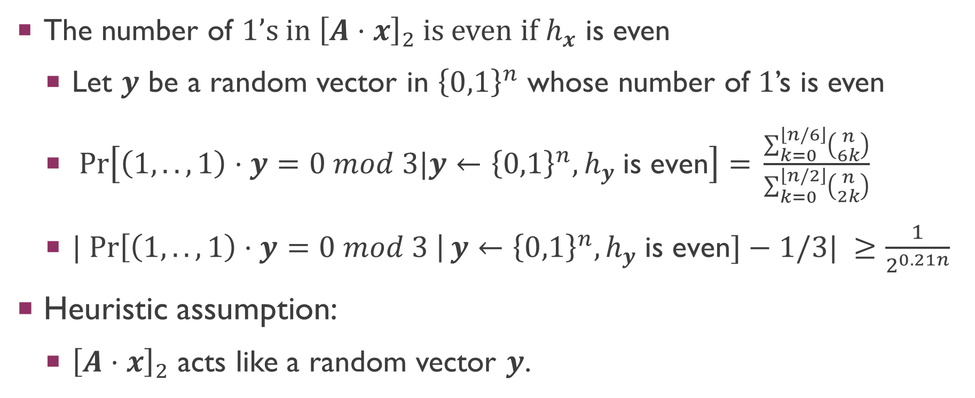
Attack for new weak PRF candidate
The number of $1$’s in ${\left[A⋅x\right]}_{2}$ is even if $h_{x}$ is even
Let $y$ be a random vector in ${\left\{0,1\right\}}^{n}$ whose number of $1$’s is even
$\operatorname{Pr}\left[\left(1,..,1\right)⋅y=0 mod 3|y←{\left\{0,1\right\}}^{n}, h_{y} \text{is} \text{even}\right]= \frac{\sum_{k=0}^{\left\lfloor n/6\right\rfloor }{\left({n \atop 6k}\right)}}{\sum_{k=0}^{\left\lfloor n/2\right\rfloor }{\left({n \atop 2k}\right)}}$
$| Pr\left[\left(1,..,1\right)⋅y=0 mod 3 \right|y←{\left\{0,1\right\}}^{n}, h_{y} \text{is} \text{even}]−1/3| ≥\frac{1}{2^{0.21n}}$
Heuristic assumption:
${\left[A⋅x\right]}_{2}$ acts like a random vector $y$.

Slide 24
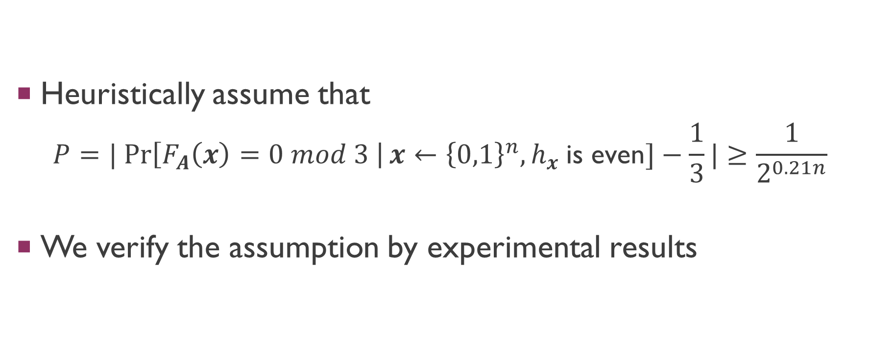
Attack for new weak PRF candidate
Heuristically assume that
$$P=| Pr\left[F_{A}\left(x\right)=0 mod 3 \right|x←{\left\{0,1\right\}}^{n}, h_{x} \text{is} \text{even}]−\frac{1}{3}|≥\frac{1}{2^{0.21n}}$$
We verify the assumption by experimental results

Slide 25
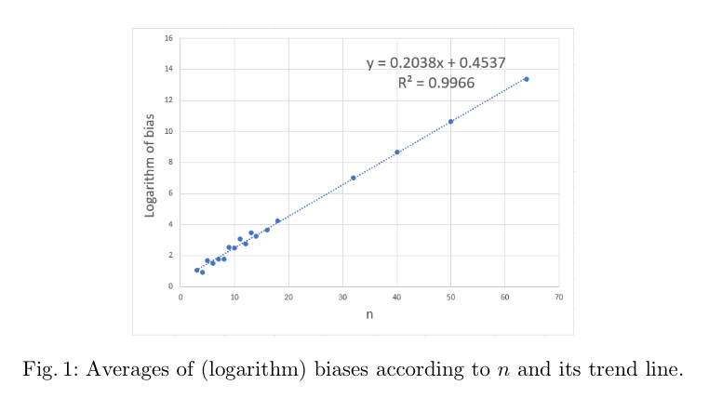
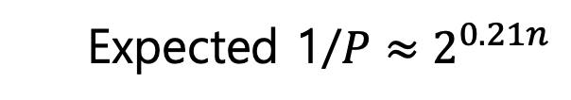
Experimental Results for several $n$
Our experimental results show that
Expected 1/$P≈2^{0.21n}$
Notes:
[31] Now let’s see experimental results.
We draw a trend line according to various n.
The y axis is the logarithm of a value P inverse.
The logarithm trend line is almost the same as our expectation for several n. So our assumption is valid.
더 할 수 있는 얘기가 없나?

Slide 26
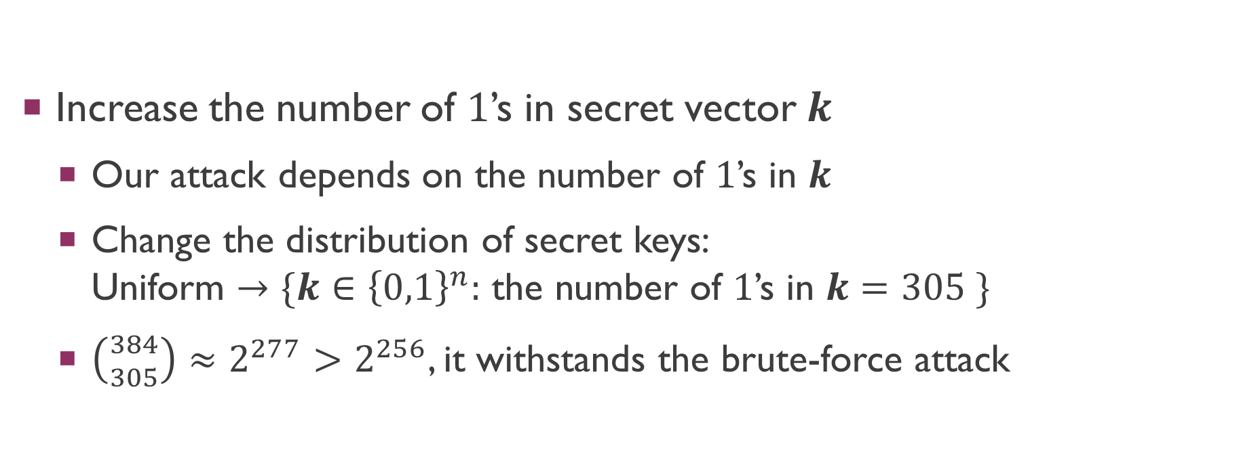
How to (heuristically) Fix?
Increase the number of $1$’s in secret vector $k$
Our attack depends on the number of $1$’s in $k$
Change the distribution of secret keys: Uniform $→$ $\{k∈{\left\{0,1\right\}}^{n}:$ the number of $1$’s in $k=305 \}$
$\left({384 \atop 305}\right)≈2^{277}>2^{256}$, it withstands the brute-force attack

Slide 27
How to (heuristically) Fix?
Circulant matrix
by vector a
Half-Circulant matrix by vector a
Half-Circulant matrix by vector b
Break circulant matrix
Choose two random vectors and combined half-circulant matrix of random vectors
It preserves the advantages of the circulant matrix

Slide 28
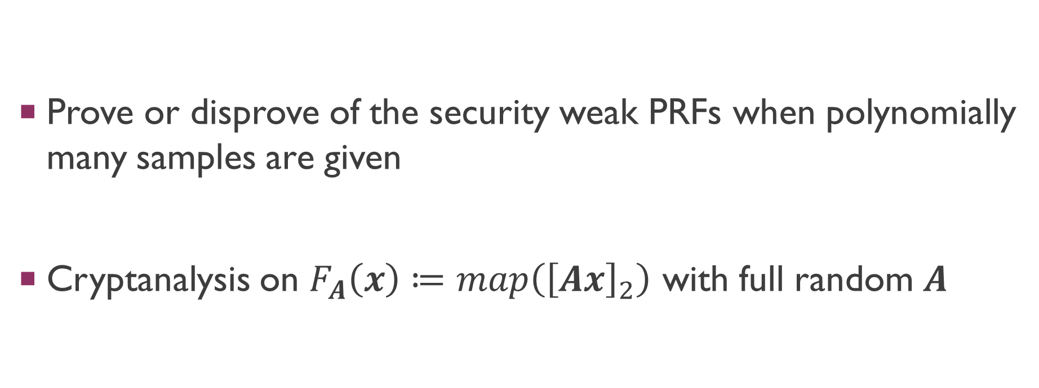
Open questions
Prove or disprove of the security weak PRFs when polynomially many samples are given
Cryptanalysis on $F_{A}\left(x\right)≔map\left({\left[Ax\right]}_{2}\right)$ with full random $A$

Slide 29
The end

